Slide 1
Administration support staff and Kaiārahi i te Reo pay equity settlements
Webinar for schools and kura
August 2022

Slide 2
Karakia timatanga
I acknowledge those guests who are new who hail from the four winds and who descend from all canoes.
Welcome welcome.
I am joyful that you have arrived.
On that note my esteemed colleagues, I greet you; I greet you; I greet you all.
E ngā hau e whā e ngā mātā waka e ngā waewae tapu
Nau mai haere mai tēnā koutou katoa
E koa ana te ngākau kua tae mai koutou ki te whakanui
i te kaupapa o te rā
Nō reira e aku Rangatira tēnā koutou tēnā koutou tēnā koutou katoa.

Slide 3
Presenters
Maynard Scott and Kate Lethbridge, New Zealand School Trustees Association
Paul Barker and Sonya Hockley, Principals, NZEI Te Riu Roa
Bee Groves and Tessa Townsend, Claims Implementation Team, Ministry of Education
Queries panel
Ellie Good and Sophie Dickson, Pay Equity Team, Ministry of Education
Tejal Patel, Resourcing Team, Ministry of Education
Kāmaia Takuira-Mita and Carrie-Ann Carrasco, Claims Implementation Team, Ministry of Education
What we will cover today
What is in the settlement, who it covers, funding for schools and kura, the four actions needed now and where to find more information and support.
Notes:
This webinar is an operational introduction to pay equity implementation. We are covering what is in the settlement, who it covers, funding for schools and kura, the four actions needed now and where to find more information and support.

Slide 4
Ongoing support
Ohumahi Support Team
Ministry of Education is available for general enquiries relating to pay equity or funding at ohumahi.support@education.govt.nz, or on 0800 114 117
Visit the Taku portal on education.govt.nz/taku
NZEI Te Riu Roa
NZEI Te Riu Roa is available for employees to seek advice on employment matters.
NZEI Te Riu Roa can be contacted by emailing nzei@nzei.org.nz or on 0800 693 443
NZSTA
Schools, kura and school boards should seek advice from NZSTA for employment relations questions or specific questions for managing staff.
NZSTA can be contacted by emailing eradvice@nzsta.org.nz, or on 0800 782 435 (option #2)
Education.govt.nz > search ‘Administration support staff pay equity’ > click first option
Education.govt.nz > search ‘Kaiārahi i te reo pay equity’ > click first option
Notes:
You can contact any of the support teams at the Ministry of Education, NZEI Te Riu Roa or NZSTA for further queries and assistance.
The guidance we will discuss today is available now on all of our websites, with more to come as it is released.

Slide 5
Pay equity claims overview
RAISING
ASSESSING
SETTLING
IMPLEMENTING
LODGED
ARGUABILITY
CLAIMANT
INTERVIEWS
COMPARATOR
INTERVIEWS
SETTLING
GUIDANCE RELEASED
FUNDING TO SCHOOLS AND KURA
PAYMENT TO COVERED EMPLOYEES
Notes:
As we know, NZEI Te Riu Roa raised both pay equity claims in September 2018.
Interviews were conducted and then, in August 2021, sex-based discrimination was confirmed for both pay equity claims.
On 4 July 2022, NZEI Te Riu Roa and the Ministry reached an agreement for both claims.
Which brings us to now, the implementation stage of the pay equity claims.
From now, you, as employers and implementors, have actions you must take to ensure these claims are implemented successfully. We are covering these actions today.

Slide 6
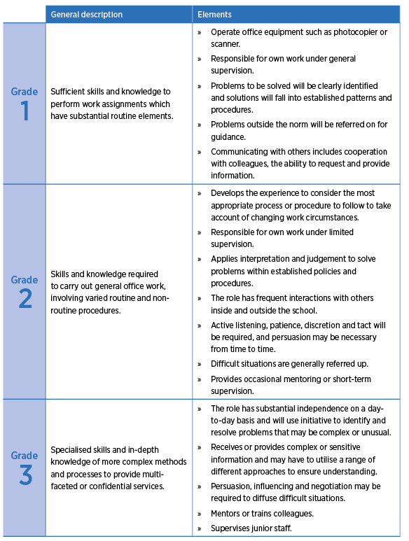
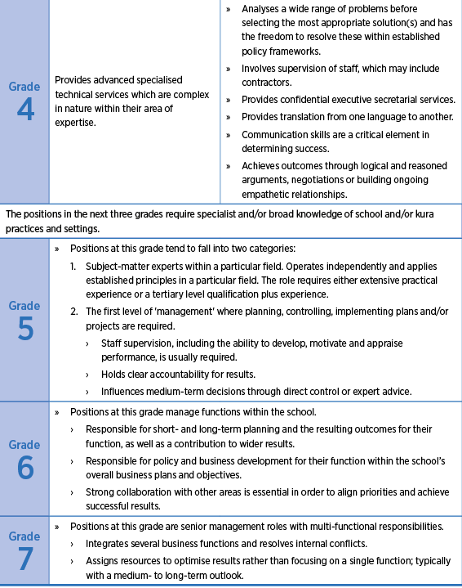
Who is covered by the settlement
Administration support staff in schools
School administration support staff and anyone who completes tasks described in the Work Matrix, employed in state or state-integrated schools and kura.
Administration support staff job titles include:
Personal/Executive Assistants
Financial Administration
Inquiry Clerks and Receptionists
Administrative Assistants
Executive Management
Office Management
Project, Programme and
Contract Administrators.
ACTION: Consider which of your employees may be covered by the claim
Notes:
For the Administration Support Staff Claim, employees are covered by the claim if they are routinely undertaking the work as described in the work matrix.
You can see what the work matrix looks like on this slide. You will find the work matrix in the settlement agreements, and our Work Matrix Guidance is available now on all of our websites.
On this slide, you can see examples of job titles that are covered by the APEC claim. This list isn’t exhaustive, but it gives a good indication of the types of employees that are covered.

Slide 7
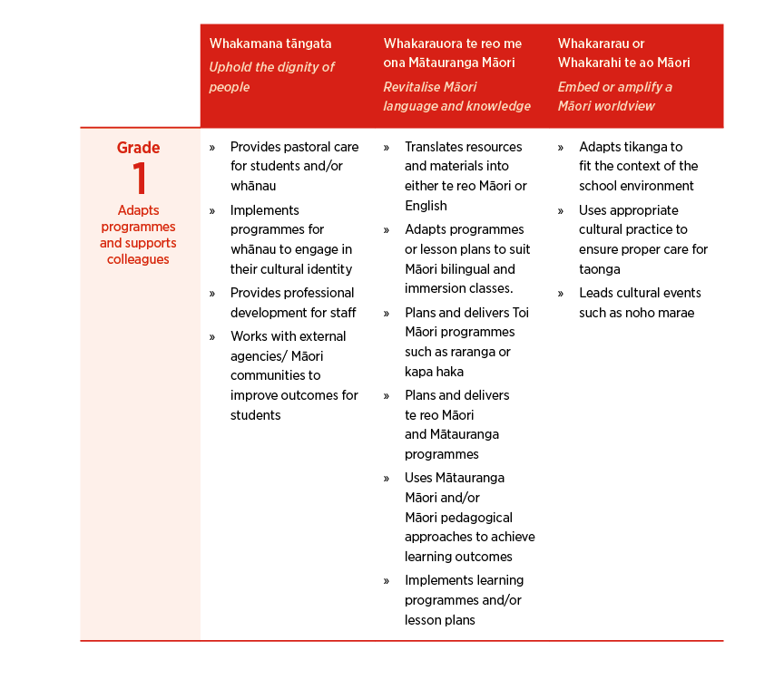
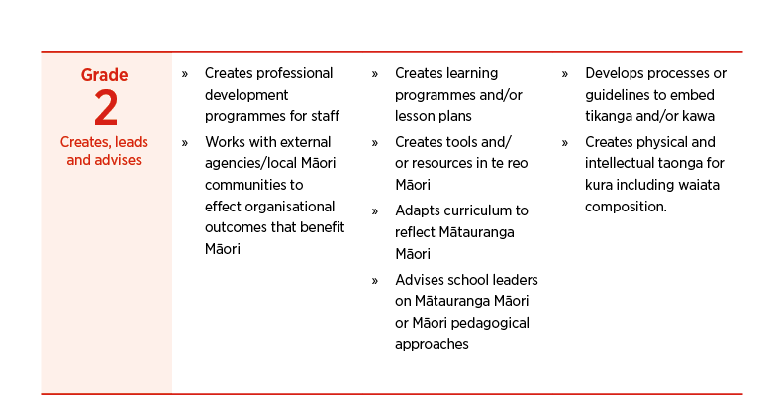
Who is covered by the settlement
Kaiārahi i te reo in schools and kura
Kaiārahi i te reo and anyone who completes tasks described in the Work Matrix, employed in state or state-integrated schools and kura.
Kaiārahi i te reo role
Kaiārahi i te reo support the development and preservation of te reo Māori and tikanga Māori within schools and kura. They are recognised for their involvement within the wider school/kura community and their knowledge and experience of mātauranga te ao Māori.
Kaiārahi i te reo contribute to creating inclusive and safe spaces by growing the cultural capability of school staff and students.
ACTION: Consider which of your employees may be covered by the claim
Notes:
Just like APEC, employees are covered by the kaiārahi i te reo claim if they are routinely undertaking the work as described in the KPEC work matrix.
As we know, Kaiārahi i te reo support the development and preservation of te reo Māori and tikanga Māori.
You can see the work matrix on this slide. The work matrix is in the settlement agreements, and our Work Matrix Guidance, which will help you understand how to use the work matrix going forward, is available now on our websites.
When thinking about both APEC and KPEC, consider if you have employees that are (or should be) covered by either settlement.
After today’s webinar, you may feel that you have an employee who should be covered by one of these settlements, because they are undertaking work that is the same, or substantially similar, to what is described in the work matrix. If this employee is on the correct designation code, (we will cover designation codes shortly) but that designation code is not listed, please contact our support teams for further assistance.

Slide 8
What is included in the settlement?
Administration support staff claim
Kaiārahi i te reo claim
New work matrix
New work matrix
New pay equity rates
New pay equity rates
Overtime clause
Parental payment
Updated role definition
ACTION: Make a note today of areas where you need to know more, need advice and support
Parental payment
Notes:
For the Administration Support Staff Pay Equity claim, the outcomes that came from the settlement were;
A new work matrix, which better acknowledges the value of administration support staff roles. The new APEC work matrix has seven grades, which (along with their step) determine the pay rate of an employee
New pay equity rates, which range from $22.75 to $55.62 per hour and are effective from 20 August 2021
Parental payment provision, which is a lump sum payment made to administration support staff who return to work for six months after taking parental leave. The Ministry of Education will release guidance specific to parental payment.
For the kaiārahi i te reo claim, the settlement brought;
A new work matrix, which has two grades. These new grades will determine the pay rate of a kaiārahi i te reo employee.
New pay equity rates which range from $37.56 to $46.94 per hour and are effective from 20 August 2021
An overtime clause, so if a kaiārahi i te reo employee works overtime they are paid for this work
An updated role definition to reflect the unique role that kaiārahi i te reo play in kura and schools
And a parental payment provision which is a lump sum payment made to kaiarahi i te reo who return to work for six months following a period of primary carer leave.

Slide 9
What employees can expect
Employees will be auto translated to the new rates and will see their pay equity increase on 18 October 2022.
Employees will progress through the steps in their grade annually, on their anniversary date.
Ongoing funding will be provided to cover the increased cost of these settlements.
New employees, and those changing roles, will be placed using the new work matrix.
New employees will be informed that they are covered by the collective agreement for the first 30 days of their employment, and they can fill out the active employee choice form to remain covered.
Former employees may be eligible for some payment, and further guidance will be released on this shortly.
NZEI Te Riu Roa will be providing support throughout the pay equity process.
Notes:
I’m really pleased as a principal to see this pay equity settlement for administrators and kaiārahi i te reo in schools and kura. I know from my own experience that administrators are “the oil” that keeps the school working. I could not do my job without them and it’s great to see them get the recognition they deserve.
Kaiārahi i te reo are also being recognised for their mahi and contribution to the revitalisation of te reo Māori, tikanga Māori, and mātauranga Māori. The impact their mahi has on kaiako, teachers, kura, schools, and our communities is significant.
Part of our job as principals and implementors is to make sure that administrators and kaiārahi i te reo get their pay increases as smoothly as possible. This is where the on-the-ground knowledge and processes are vital.
So firstly, administrators/Kaiarahi i te reo will be auto-translated to their new rate. This is done by Education Payroll. This includes all of those on Individual Employment Agreements. It is important administrators/Kaiarahi i te reo are on the correct designation codes.
We have a date for payment! Administrators and Kaiarahi I te reo will see the pay equity increase in their pay on 18 October, this year. It will contain a lumpsum for the extra pay accumulated from the effective date of settlement of 20 August 2021.
This lumpsum amount will be taxed. The payment will look different for everyone, because this money is a payment for work that employees have actually done, rather than a flat lump sum payment that is the same for everyone.
The payment will include any anniversary date between 20 August 2021 and now. Going forward, employees will progress through the new steps within their grade annually. If your employee doesn’t have an anniversary date, their progression through the steps is now every year on 21 August.
The settlements are funded by separate new money, so there is no reason employees hours of work should be reduced because of a pay equity settlement.
From now on - new employees, and those changing roles, will be placed on the new grading matrices. These matrices better reflect the skills, responsibilities, and demands of Administration and Kaiārahi i te reo roles.
New employees also need to be informed that they are covered by the collective agreement for the first 30 days of their employment. After that, they can fill out the active employee choice form. ​
Those administrators who have left their jobs since the effective date may be eligible for some payment. Guidance for former employees will be released shortly on our websites.
NZEI Te Riu Roa will provide support for members to make sure that they get the correct payments or if they need help in the pay equity regrading process.

Slide 10
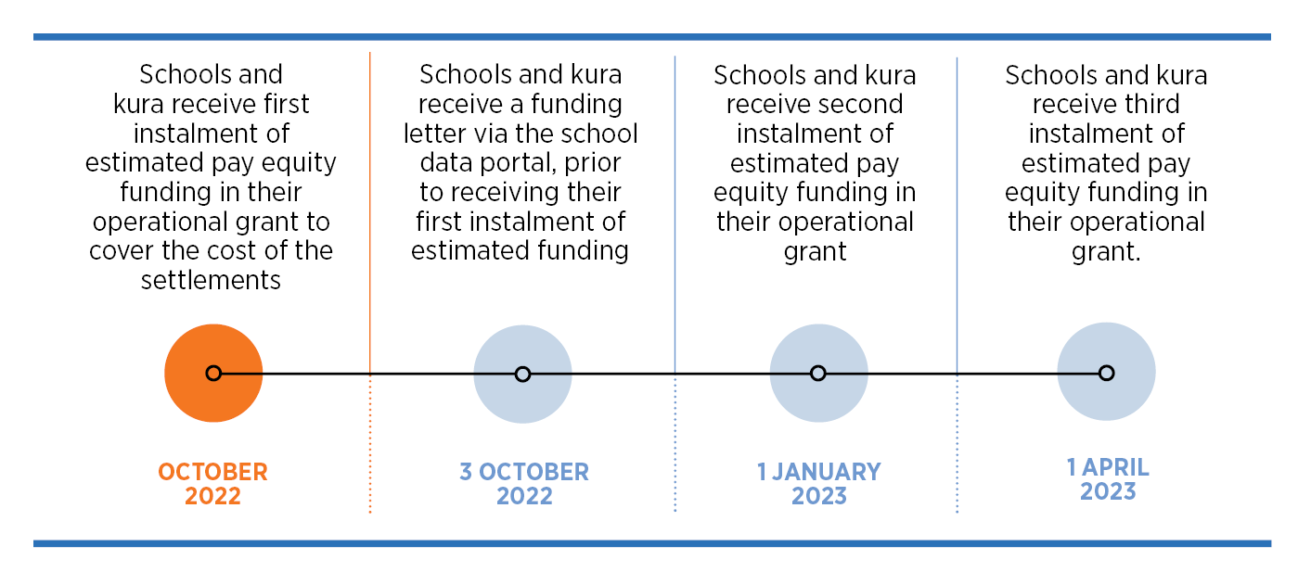
Funding – What you can expect
Ongoing funding will cover the increased cost of the pay equity settlements.
Funding is paid as part of your operational grant, first instalment scheduled for 3 October 2022.
Schools are required to use settlement funding to pay the new pay rates.
There is no action required by schools and kura to receive funding.
More information is available within Funding 101 Guide
Notes:
Ongoing funding will be provided to schools and kura to cover the increased cost of the administration support staff and the Kaiārahi i te reo settlements.
This funding will be paid as part of your operational grant instalments. Your first operational grant instalment is scheduled for 3 October 2022 (1 October is a Saturday). We will use 2021 payroll data to estimate how much additional funding you will require to cover both pay equity settlements. This estimate covers the cost of the point-to-point translation from the pay scale in the previous CA to the new pay equity pay scale.
Schools will receive a funding letter via the school data portal, prior to receiving their first instalment of estimated funding.
Schools are required to use the additional settlement funding to apply the pay equity outcomes and new pay rates.
Payment to covered employees will be made on 18 October 2022
We will cover the pay equity regrading and funding process shortly, however, it is important to note that any funding for pay equity regrading is additional to the settlement funding, and specific criteria need to be met to receive this funding.
On 1 January you will receive the next instalment of estimated funding for the pay equity settlements, and then the next instalment on 1 April
Apart from pay equity regrading funding, which we will cover shortly, There is no action required by schools to receive settlement funding. This is because all settlement funding will be calculated and paid automatically.
However, you should be familiar with the funding 101 guide. The funding 101 guide outlines the additional pay equity funding you will be receiving. You can find funding guidance on the websites now.

Slide 11
The basics of point-to-point translation
Translation is the process to move from the old pay rates to the new.
Translation will be done automatically by Education Payroll for all covered employees.
You do not need to do anything to translate your employees' grade and step.
Covered employees will automatically receive the new pay equity pay rates on 18 October 2022.
If your employee feels they have been incorrectly translated, they can agree with you to review their grade through the pay equity regrading process.
Current grade and step | Current hourly rate | Translation grade | Translation step | Translation rate
A1 | $21.78 | 1 | 1 | $22.75
B1 | $21.78 | 2 | 2 | $24.38
B2 | $21.95 | 2 | 4 | $26.01
C2 | $21.95 | 3 | 5 | $26.64
Notes:
Point to point translation means the movement between the employees' old grade and step to their new grade and step as defined by the new work matrix. Each old grade and step has a corresponding new grade and step. You can see an example of point-to-point translation on this slide. There are point-to-point translations (and guidance) for each claim and collective.
Covered employees, who are on a covered designation code, will be translated automatically. Other than the action of checking your employee's designation codes, you don’t need to do anything to translate the employees on those codes from the old rates to the new rates.
As mentioned earlier in the presentation, if you believe that an employee on another designation code is undertaking work that is the same, or substantially similar, as what is described in the work matrix on a routine and ongoing basis and should therefore be covered by the settlement, please contact our support teams.
When administration support staff and kaiārahi i te reo covered by the claims automatically receive the new pay equity pay rates by 18 October 2022, they will also be paid any difference in rates since 20 August 2021, or their start date, whichever is later. This is because 20 August 2021 is the date the new pay equity rates came into effect.
If you or your employees have questions on how the point-to-point translation is achieved, the translation guidance outlines this process in detail. You can find this guidance on all of our websites.

Slide 12
What you need to do
ACTION 1: Review designation codes in EdPay
ACTION 2: Check your employees' information and distribute letters
ACTION 3: Make sure employee agreements and other documents are up to date
ACTION 4: Know how to apply for pay equity regrading and understand the funding for pay equity regrading
Notes:
This brings us to the direct actions you need to take to help successfully implement these pay equity claims. We will be going into each of these actions in detail over the following slides, presented by our subject matter experts. Your actions include:
Reviewing designation codes in Education Payroll
Checking the information you receive on your employees, and making sure they get the letters they need
If needed, updating employment documents
Knowing how to apply for pay equity regrading and understanding the funding for pay equity regrading

Slide 13
ACTION 1: Designation codes
A designation code doesn’t determine an employee's pay rate, but designation codes are used as a reference for Education Payroll.
Employees must be on the correct payroll designation code in Education Payroll.
If your employee is not on the correct code, they will not be paid the new rates.
Designation code | Description
S57 | Kaiārahi i te reo
Designation code | Description
S70 | Admin – Executive/Clerical
S71 | Admin – Executive Management
S72 | Admin – School Secretaries
S73 | Admin – Secretarial/Typing
S75 | Admin – Administrative Services
S41 | School Secretaries
S42 | Executive Clerical
S43 | Secretarial/Typing
S64 | Executive Management
S65 | Administrative Services
ACTION: Log in to EdPay to the ‘My Employees’ tab to check your employee’s Designation Code is correct
ACTION DUE: By 30 September 2022
Notes:
Designation codes are payroll codes that let Education Payroll know what type of work your employees are undertaking.
Designation codes don’t reflect an employee's remuneration, so you can (and likely do) have employees on different pay grades or steps, who hold different levels of skill or responsibility on the same designation code.
Designation codes don’t determine an employee's pay rate, but designation codes are very important for the pay equity implementation process. Education Payroll will use the designation codes listed here as a reference to know which employees to pay the new pay equity rates to.
So, if your employee is an administrative staff member or a kaiarahi i te reo but is not on one of these listed designation codes, Education Payroll won’t know the type of work your employee does and they will not be paid the new rates.
Administration employees should be on the designation code that best reflects their work. Kaiārahi i te Reo employees should be on designation code S57.
Your employees need to be on the correct designation code as soon as possible. You can check and change your employee's designation codes by viewing your My Employee’s Tab in EdPay, we need you to compete this by 30 September 2022.

Slide 14
ACTION 2: Check information and send letters
Summary report
The Ministry will call you to confirm your covered employee information.
You will receive a summary report of your covered employees. The report will include your employee’s name, designation code and their current grade and step.
Letters
Letters will be sent to your employees at different stages over the next few months
Letter to employees who opted out.
Letter to employees who were not notified of claim.
Letter to covered employees, with their point-to-point translation.
ACTION: Check the summary report against information in your ‘My Employee’s’ Tab in EdPay
ACTION DUE: By 30 September 2022
ACTION: Give letters to your employees
Notes:
The Ministry has started calling schools and kura from 2 August 2022 to confirm current payroll information for covered employees. You will receive a summary report that includes your covered employee’s name, designation code and their current grade and step.
Please review the information in the summary report against your payroll information. Check that the list of employees is as you would expect and that their designation codes, current grade and current step is correct. If any changes to an employee’s payroll information is required, please do so through EdPay by 30 September 2022.
You don’t have to wait for a phone call from the Ministry of Education or a summary report if you know that your employee’s information needs to be updated. You can check and change your employee’s information by viewing your My Employee’s Tab in EdPay. You can also find this information through your Staff Usage and Expenditure (SUE) report.
Please note that you can expect the call from Ministry between now and until end of September 2022. If you don’t receive a call, please reach out to our support team
Letters
Over the next few months, we will be sending letters to your employees. These letters include;
A letter to employees who opted out, which will be offering them the benefit of the settlement
A letter to employees who were not notified of claim, offering them the benefit of the settlement
And a letter to covered employees, informing them of their point-to-point translation. This letter may be sent after payment is made, however is still important information for employee's records.
We will need you to give these letters to your employees. It’s also good practice to take a copy and store these letters on your employees' files.

Slide 15
ACTION 3: Employment documents
Collective and Individual Employment Agreements will be automatically varied to include the pay equity claim.
Business as usual – Employment documents
All employees need a:
Signed letter of offer
Records of changes to hours or pay rates
An accurate job description
If not a member of a union, an IEA.
Job descriptions
Job descriptions are living documents which outline the purpose of a position and that duties are expected to be carried out.
ACTION: Offer your employees the most up-to-date IEA (either the 21 June or the 4 July IEA)
ACTION: Check you have up-to-date documents for your employees
Notes:
Firstly, a union member’s Collective Agreement automatically varies to incorporate the benefits of the Pay Equity Claim. The same applies for non-union employees, employed on Individual Employment Agreements, or IEA’s. Your employees don’t need to sign anything to get the new pay equity rates.
So, what is required from a documentation point of view? Well, if everything is up-to-date, not much. If not, now is when you should be getting everything in order. The items on the screen are what you should already have up to date and on file as business as usual:
The letter of offer should have been signed when the employee started work and should be on file to readily refer to if needed. This letter will detail important information like the rate an employee started on, their job title and conditions.
You should also have additional letters that are provided to an employee to confirm pay progression or changes in days or hours worked, which again should be readily available on file.
Employees also need an accurate job description. It is a separate document to the letter of offer and should not be combined with the letter of offer.
Job descriptions are living documents. This means is it is not a document you roll over without thought - whenever there is a change to the employee's regular duties, you should be updating the JD in enough detail to help both parties understand what is expected in an employee’s day-to-day work.
If you have employees with out-of-date job descriptions, now is the time to update them. This updating should be done through the lens of the work matrix – tasks, duties and purposes should be expressed using the terms and framework of the matrix (key descriptor words like substantially routine, varied, non-routine, in-depth knowledge, complex, confidential, advanced knowledge, expertise, specialised knowledge, multifunctional, management), so it is clear why they are on the grade they are on.
NZSTA has job description templates available on our Resource Centre for your use. Note that employers cannot arbitrarily add or take away duties from an employee – there must be consultation with the employee and changes must be made in good faith.
As a matter of good housekeeping, and to ensure that employees on IEA’s receive the benefits (over and above the pay equity benefits) of the recently settled Collective Agreements, we encourage you to offer employees the most up-to-date IEA. You can find the IEA’s on the Ministry of Education website. Any updates you do from today on, please use the new 4 July IEA template.
All these documents are important, firstly because it is required by law, but also because if there ends up being some concern with the rate that an employee is automatically translated to, these documents will play a part of the pay equity regrading application process. We will cover the pay equity regrading application process next.
If you have issues with any of this documentation, NZSTA can assist employers on next steps and employees can seek advice from NZEI Te Riu Roa.

Slide 16
ACTION 4: Pay equity regrading
In exceptional circumstances, an employee may be automatically translated to a grade that does not reflect the skills and responsibilities of their role.
If this happens, they can agree with you to review their grade.
ACTION: Make eligible applications for pay equity regrading through your Taku portal
ACTION DUE: Before 15 March 2023
More information is available in the Pay Equity Regrading Guide
Notes:
Occasionally, an employee may be automatically translated to a grade that does not reflect the skills and responsibilities of their role. If this happens, they can agree with you to review their grade.
If an employee believes they should be on a higher grade, they should raise this with you.
Pay equity regrading can’t be used to change the step within a grade.
Pay equity regrading can’t be used for a change in responsibilities or to correct an historic employment or grading error. These changes would go through the normal regrading process.
You cannot apply for a downwards regrade.
If an employee requests to be regraded, you should meet with them to talk through their role, job description and responsibilities, referring to the new work matrix. You should also look at the criteria in the Pay Equity Regrade Guidance. If needed, NZSTA can assist employers with these conversations, and NZEI Te Riu Roa can help employees.
If you both agree they should be on a higher grade, you can apply for pay equity regrading and the associated funding. You apply for pay equity regrading through Ministry of Education’s TAKU portal, using your ESL log-in
The settlement agreements allow for employees to request a pay equity regrade from the start of term 3 2022.
Employees can request pay equity regrading up to 28 February 2023.
You should complete an application before 15 March 2023 and, if the application is declined, you can appeal until 31 March 2023.
If an application is approved, your employees new pay rate would be applied from 20 August 2021, or the date they commenced their role. This means that some employees will translate twice! Once on 18 October for their automatic translation, and then again after your pay equity regrade application is approved.

Slide 17
ACTION 4: Pay equity regrading – Funding
All employees’ automatic point-to-point translation will be funded.
Pay equity regrade funding is additional funding to cover a pay equity regrade for an employee.
When can I expect the additional pay equity regrade funding?
All approved and partially approved pay equity regrading applications will receive funding no later than July 2023.
More information is available in the Pay Equity Regrading Guide
Notes:
All of your employee’s normal point-to-point translations will be funded automatically.
The pay equity regrade funding is additional funding to cover the ongoing costs of an employees change in grade.
If your application is declined, we will call you to talk you through the reasons for decline, the appeal process, and next steps for you and your employee.
When am I being funded
We expect the first funding for pay equity regrade funding to be made no later than July 2023. When we let you know the outcome of your application, we will also let you know when to expect funding.
You’ll find the pay equity regrading guidance on all of our websites now.
We are working on releasing the guidance on pay equity regrade funding as soon as possible. We will let you know when the pay equity regrade funding guidance is available.

Slide 18
Case Study: Sally
Sally is a school administrator, covered by the Administration Support Staff Pay Equity Claim.
Sally was on the old grade B, step 2 at $21.95 per hour.
Following the pay equity settlement, her grade will be automatically translated to the new grade 2, step 4, at $26.01 per hour.
The new rates are effective from 20 August 2021.
She will be paid the new rate on 18 October 2022, including the extra pay she has made since August 2021.
Current grade and step | Current hourly rate | Translation grade | Translation step | Translation rate
A1 | $21.78 | 1 | 1 | $22.75
B1 | $21.78 | 2 | 2 | $24.38
B2 | $21.95 | 2 | 4 | $26.01
C2 | $21.95 | 3 | 5 | $26.64
Notes:
So, those are your 4 actions. A reminder that these slides and scripts will be available on the NZSTA website for reference.
We are now going to run through some pay equity case studies.
Here’s an example of how automatic translation will work. It helps to have the auto-translation graphic and new work matrix to hand.
This is Sally, Sally is a school administrator, covered by the Administration Support Staff Pay Equity Claim
Prior to the APEC settlement, Sally was on grade B, Step 2 at $21.95 per hour. Following the pay equity settlement, her grade will be automatically translated to the New Grade 2, Step 4 and she will be earning $26.01 per hour from 20 August 2021.
Her school does not need to notify Education Payroll as her pay rate will translate automatically.
Sally will see the pay equity increase in her pay on 18 October, this year. It will contain a lumpsum for the extra pay accumulated from 20 August, 2021. This lumpsum amount will be taxed.

Slide 19
Case Study: Manaia
Manaia is a kaiārahi i te reo, covered by the claim.
Manaia’s anniversary date is on 5 June every year.
On 20 August 2021, Manaia was on the old step 6, which translates to the new grade 2, step 2.
On her anniversary of 5 June 2022, Manaia changed to the old step 7, which translates to the new grade 2, step 3.
Manaia’s pay equity payment will include all extra pay from 20 August 2021, including the extra pay from her change in step on her 2022 anniversary date.
21/08/21 – 04/6/22 Grade 2, step 2
05/06/22
Grade 2, step 3
20/08/21
Step 6
Current step | Current hourly rate | Pay equity grade | Pay equity step | Pay equity hourly rate
1 | $21.78 | 1 | 2 | $38.50
2 | $21.97 | 1 | 3 | $39.44
3 | $22.54 | 1 | 4 | $40.37
4 | $23.03 | 1 | 5 | $41.31
5 | $23.59 | 1 | 6 | $42.25
6 | $24.11 | 2 | 2 | $44.13
7 | $25.19 | 2 | 3 | $45.07
8 | $25.79 | 2 | 4 | $46.01
Notes:
As normal, progression still happens once a year for administration support staff and kaiarahi i te reo, enabling everyone to continue to move through the steps in their grades.
Since August 2021, most people will have had an anniversary, and some will have had a change to their grade or step.
Here’s an example of what an anniversary date means for the first pay equity pay:
Manaia is a Kaiarahi i te reo. Her anniversary date is 5 June 2022.
She was on the old step 6 on 20 August 2021.
This means Manaia will translate to and be paid at the new Grade 2 step 2 for the period of 20 August 2021 to 4 June 2022.
Then, on her anniversary from 5 June 2022, she will progress to the old step 7, which translates to the new Grade 2 , step 3.
On 18 October this year, Manaia’s pay equity payment will include the pay associated with the change in step she had on her anniversary of 5 June 2022.
As we can see, the October payment for employees will include any anniversary date between 20 August 2021 and now. The payment will look different for everyone, because this money is a payment for work that employees have actually done, rather than a flat lump sum payment that is the same for everyone.

Slide 20
Case Study: Danielle
Danielle is an Accounts Administrator, covered by the Administration Support Staff Pay Equity Claim.
Danielle has been automatically translated to the new grade 2.
However, Danielle uses the school KAMAR system as a routine and ongoing part of her work. This should put her in new grade 3.
Danielle raises her incorrect translation with her school. They agree that the grade is incorrect as a result of the translation.
Danielle’s school applies for pay equity regrading and funding through the Ministry of Education’s Taku portal.
If approved, Danielle would be re-translated to the correct grade and her school would receive funding.
Notes:
In some cases, there will be administration support staff or Kaiārahi i te reo who - after translation - do not believe the work that they do is reflected by the new matrix.
As we have discussed, they can apply for pay equity regrading, in consultation with their principal or people leader. Under the settlements, employees will be able to request pay equity regrading from now until 28 February 2023
It’s important to note that the pay equity settlement’s purpose is not to rectify historic misgrading. This is something that needs to be fixed at the school level.
So, here’s an example of how pay equity re-grading might work:
Danielle does all the invoices at the school – accounts payable and receivable. She also covers reception from time to time, the school’s petty cash, school donations and money for school trips paid by parents. She does not supervise any staff.
Danielle has been automatically translated to the new grade 2. However, she does use the school KAMAR system as a routine and ongoing part of her work - and as this contains confidential information, should put her in new grade 3.
Danielle would identify that she has been incorrectly translated. She would raise this with her school. Her and her school decide that the grade is incorrect as a result of the translation. Danielles school will then apply for pay equity regrading and funding through the Ministry of Education’s Taku portal.
If the application for pay equity regrading is approved, Danielle will translate twice, once on 18 October 2022, and then again, once the application has been approved.
All approved and partially approved pay equity regrade applications will receive funding no later than July 2023.

Slide 21
Question Time
Guidance available now:
Funding 101 Guide
Work Matrix Guides
Translation Rules Guides
Pay Equity Regrading Guide

Slide 22
What next
Kaiārahi i te reo pay equity claim hui
To further support the Kaiārahi i te reo pay equity claim implementation, there are kanohi ki te kanohi hui being held across the motu.
Register for a hui in your area on the Ministry of Education’s website.
‘Sustaining pay equity’ webinar
Informational webinar on how we can all sustain pay equity in the long term.
Guidance and more
Send your pātai to our Support Teams.
Education.govt.nz > search ‘Administration support staff pay equity’ > click first option
Education.govt.nz > search ‘Kaiārahi i te reo pay equity’ > click first option
Notes:
To further support the Kaiārahi i te reo pay equity claim implementation, there are hui being held across the motu from mid august to mid September 2022.
Register for a hui in your area by visiting the Ministry of Education’s Kaiārahi i te reo pay equity claim website, or you can email our Ohumahi Support Team.
Sustaining pay equity webinar
Pay equity doesn’t stop here. NZSTA, NZEI Te Riu Roa and the Ministry of Education will be hosting further webinars on the actions you can take to help sustain pay equity in the long term.
We will cover topics like:
Hiring new employees
And using the work matrix for new employees
More information on these webinars will be available shortly.
In addition, if there's a topic that you want to know more about – let us know! Contact any of our support teams with questions and ideas.
Guidance and more
As we know, there is guidance available now on our websites, and there is more to come as we move through the implementation process.

Slide 23
Karakia whakamutunga
Tēnā anō tatou
Tēnei au ka mihi atu
Mō te pai o tā tātou noho tahi
Me te ātaahua o ngā kōrero
Nō reira e aku rangatira
Hoki pai atu ki ō koutou tari
Ki ō koutou kāinga
Ki ō koutou whānau
Kāti rā tēnā koutou tēnā koutou tēnā koutou katoa
I greet you all.
I thank you for an excellent meeting and for the high quality of discussion.
On that note my esteemed colleagues, may you return safely to your offices, to your homes and to your families.
Thus, I greet you, I greet you, I greet you all.

